Slide 1
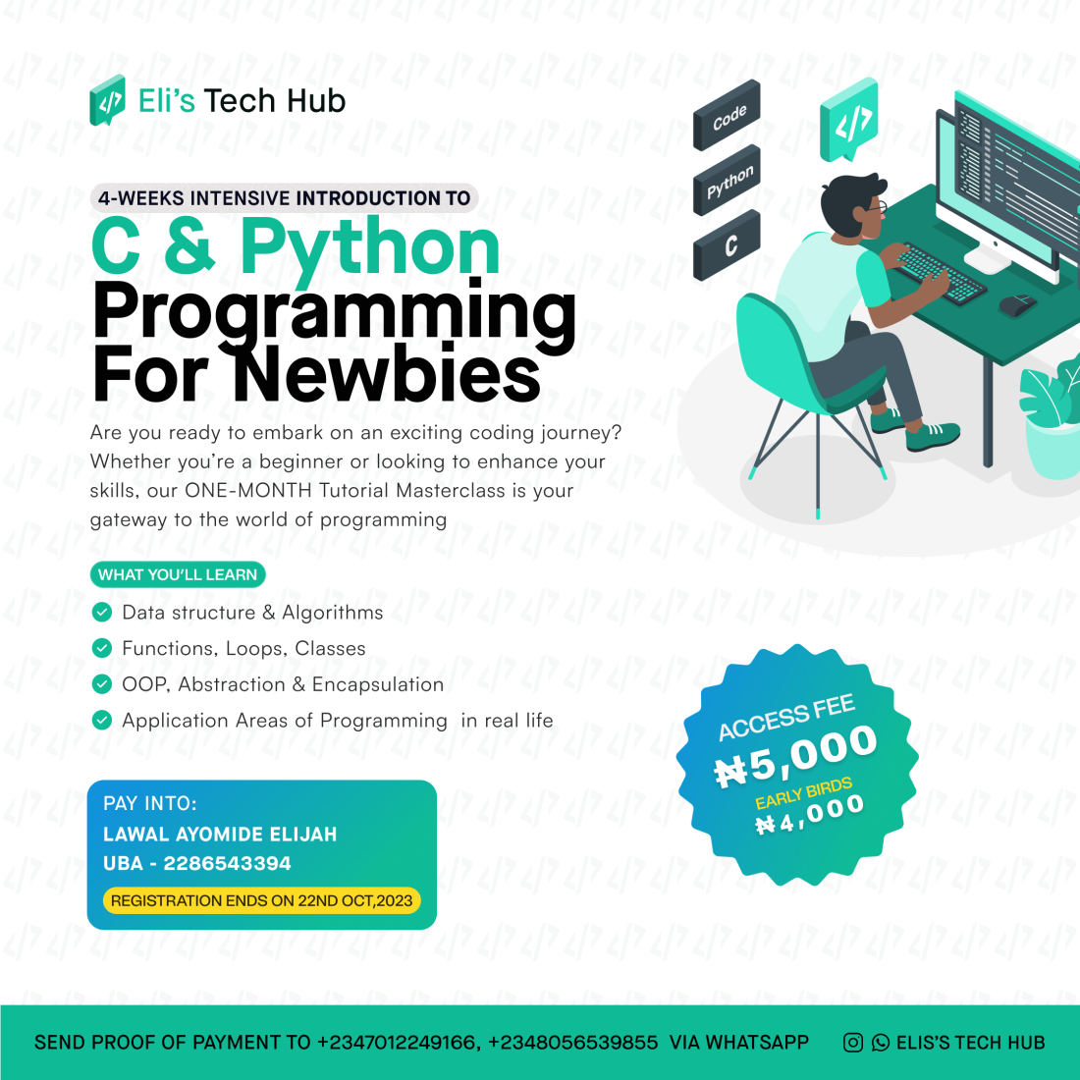

Slide 2
Programming with C and Python for Newbies
Day 1: Course introduction and Basics of programming

Slide 3
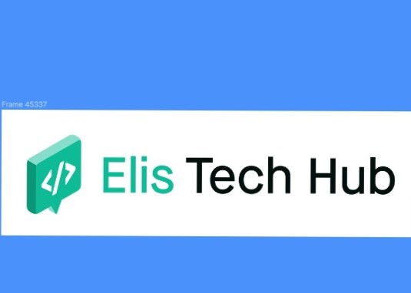
Course Outline
Course introduction, Basics of programming,
Variables, Data types ,syntax in C
Conditions: if, else-if, else statements
Arrays and operations on arrays
Loops: for ,do-while loop and while loop..
Functions
User input and Validation
Data structures
Introduction into Python, syntax &data types
Conditions: If, else and elif statements
Python lists and operations on list
Loops: For loops, while loops
Functions
Building projects with C and Python
Final Projects, Exam, Conclusion(Application areas of what we have learnt

Slide 4

Programming
This is simply the process of communicating with your computer
It means giving instructions to a computer to perform tasks
These instructions are written in a language that computers can understand i.e programming languages

Slide 5
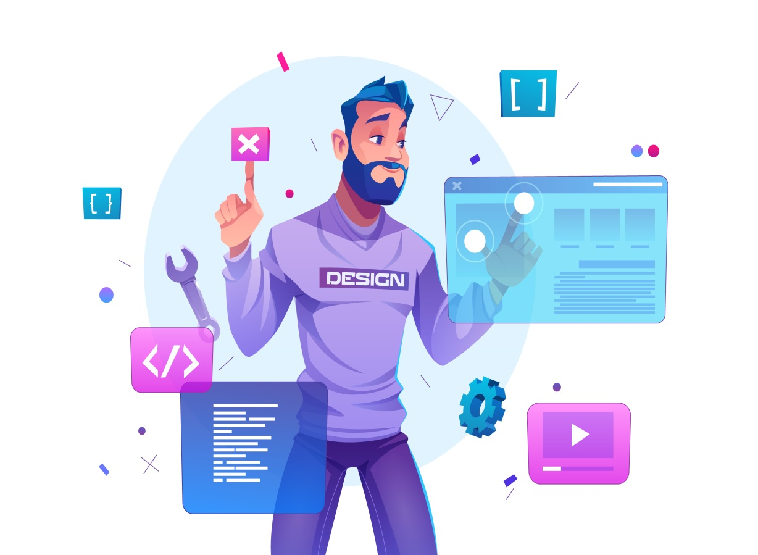
Programming languages
We have a lot of programming languages in the world today. Some of them are:
Python
C
C++
R
Javascript
Java
Ruby
Etc…

Slide 6
Introduction into C
C is a compiler programming language that translates the entire source code into machine code before execution i.e it compiles the code once and can be run multiple times.

Slide 7
Installing C

Slide 8
Writing our first Program in C

Slide 9
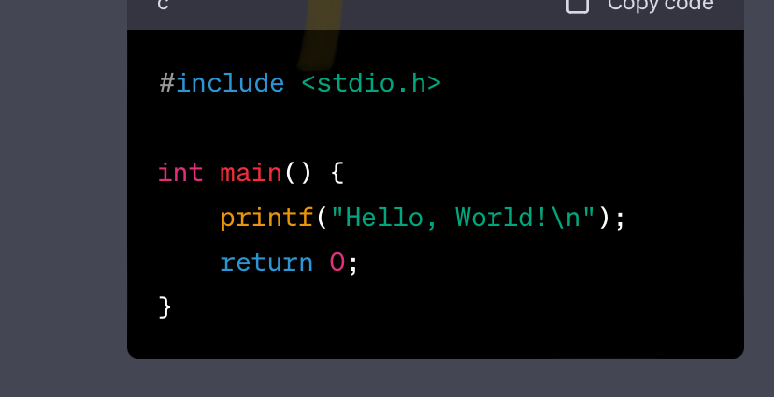
This is the first program every programmer writes.
It’s like the cry a baby makes immediately after birth!

Slide 10

Assignment
Write a C program that prints out your name on the screen

